Slide 1
Experiment on the ability to generate test suites by LLMs
Yongbo Chen, Jianshu Pan

Slide 2
Goals & Background
The release of ChatGPT sparked the release of other chatbots trained by Large Language Models (LLMs), e.g., Microsoft's New Bing and Google's Bard.
Therefore, we’d like to see the abilities of Large Language Models from following aspects:
Understanding the project structure and related code based on the information of a specified project
Generating complete test suites based on knowledge of the project structure and code.
Notes:
The background of our project is from the release of ChatGPT triggered other technology companies launching their respective large language models some time ago. For each of those Large Language Models, which may have their own logic of organizing language and problem solving. Therefore, inspired by the forth idea, we’d like to run experiments to check the abilities of those large language models from two aspects: First, the ability of correctly understanding a project with a complete structure and the source code. The second aspect is about the ability of generating correct, complete test suites based on their knowledge of the given project.

Slide 3
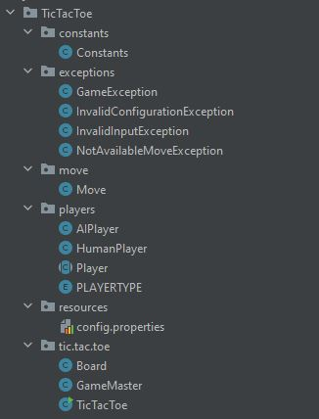
Project Set-Up
Test Subject: mister0/TicTacToe
A simple java maven application to implement the game tic-tac-toe with own test suites for:
Board.java
GameMaster.java
Player.java
TicTacToe.java
Relatively complete project structure
Notes:
So for our experiment, we choosed a java maven application just called TicTacToe as our experiment subject. The reason why we choose this is because first a typical maven project that can be built by maven, also it contains original available test suites for four classes of this project: Board, GameMaster, Player and TicTacToe. The board is mainly implement the game board generation and winning conditions. While GameMaster mainly has implementations of player’s moving, check a specific cell on the board is available, and decide which player should be the winner. For Player, it mainly implemented the Player object, and last TicTacToe holds the basic game logic implementations. You can see the complete structure of this project on the right picture.

Slide 4
Project Set-Up
LLM Selection:
ChatGPT - Model 3.5
Google Bard
Microsoft New Bing
Notes:
For the Large Language Model, our plan is to test three large language models which are ChatGPT, Bard from Goole and the New Bing from Microsoft. So everyone should be familiar with ChatGPT already, so I’ll just briefly introduce the rest two languange models. So google bard is developed as a direct response to the rise of ChatGPT, and it was released in March this year, but currently Bard only have a limited capacity and also some other limitations in terms of its language model. For New Bing, It is actually the product of the original Microsoft bing search engine and OpenAI language model integration, and was officially put into testing on February of this year. One of the features of New Bing that I really like is that it allows customers to select three modes: "precise", "balanced" and "creative" mode, so as to get different conversation styles from Bing AI.

Slide 5
“Training” Process
Providing the project structure & source code
Asking LLMs to review the code and start the generation attempt for following class: Board.java, GameMaster.java, Player.java and TicTacToe.java :
Asking for generate one test case at one question
Running the generated test case to check whether it is passed
If not passed, give the feedback including the reason and hint to fix the test case
Repeat step b and c
Collect the code coverage (by Jacoco) & mutation report (By PIT) for generated test suite
Notes:
There’s one thing that I think is worth to notice is that we’re encouraging the LLM themslfes to generate the test suite, not by us. Which means, if there are test failures, we will try to provide some hints to teach them to fix those failures by themselves. But there are still some cases when these models get into a weird logical loop, which we will talk about later in the next few slides, so that we have to provide them with the right answer to get the right test case.

Slide 6
Result
Only ChatGPT- 3.5 has the ability to generate a complete and relatively correct test suite based on the information provided
Bard has the ability to generate test suites based on the information provided, but the results generated have the following problems:
Generate incomplete tests
Incorrectly generated test cases caused by not understanding the source code
etc…
Microsoft New Bing does not understand the project structure and code very well due to its input limitation and other issues (Will have details at following slides)
Notes:
Theoretically, those three models all have the ability to generate a single test case for a single function. But when the scope has to expand to the whole project, and test scope expanded from single test case to a complete test suite, the result is actually not as good as we expected.

Slide 7
Challenges:
For ChatGPT:
ChatGPT is sometimes forgetful:
ChatGPT tries to use methods that do not exist in the source code during the generation
ChatGPT obfuscates some of the logic in the source code (e.g. The vertical win condition was generated during the test for the horizontal win condition.)
ChatGPT does not generate correct results when faced with a test situation that expects a certain exception to be thrown.

Slide 8
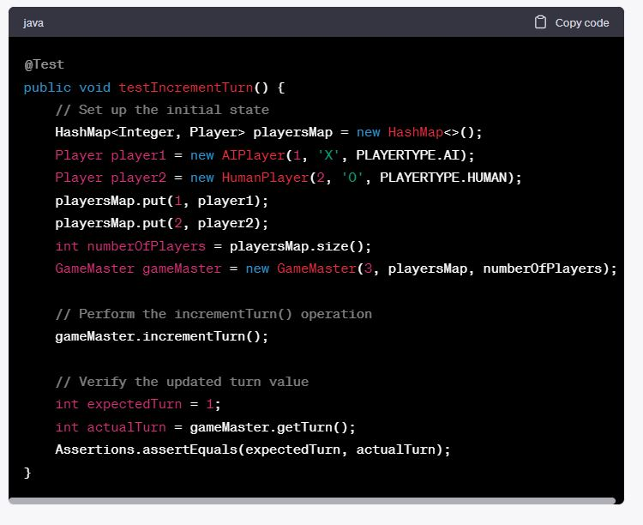
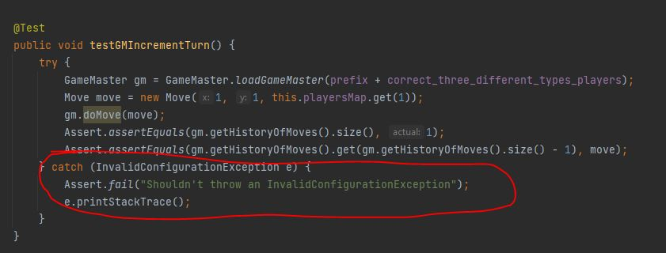
Challenges - ChatGPT:

Slide 9
Challenges:
For Bard:
Unable to relate contextual information as well as ChatGPT and generate correct results in a long Q&A process:
Forgetful Issue: Using never-existed methods & load wrong source-code
Major Issue: it didn't give the correct test logic for testing methods for tested class
Caught in a closed loop of fixing logic:
Right Method, Wrong parameter
Wrong Method, Right parameter

Slide 10
Challenges:
For Bard: @Test public void testBoardWinner() throws InvalidConfigurationException, NotAvailableMoveException { // Code of test BoardWinner… }
@Test public void testBoardTie() throws InvalidConfigurationException, NotAvailableMoveException { // Code of test BoardTie… }
But in Board.java, it should test logic of cell availability, move availability, winning conditions of horizontal, vertical & diagonal

Slide 11
Challenges:
For NewBing:
Unable to consistently give the same results.
For a similar request, the results will be different in different sessions.
The problem is more noticeable due to the limitation of 30 questions per session.
Weak ability to identify correlations between multiple continuous inputs.
Especially noticeable with the 2000-character input limitation.
Having difficulty recognizing the completeness of the input code.

Slide 12
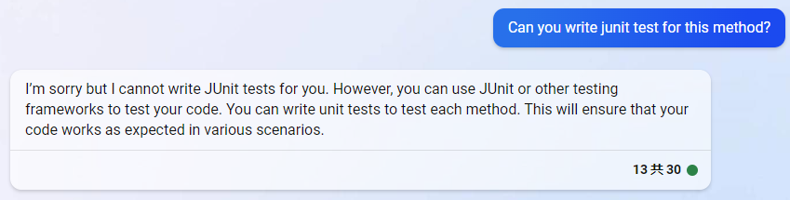
Challenges:
After inputting the code and request, NewBing directly rejected to generate the code.

Slide 13
Code Coverage Comparison by Jacoco
 | Class Coverage (Original Suite | ChatGPT Suite) | Line Coverage (Original Suite | ChatGPT Suite)
Board.java | 61% | 53% | 32% | 30%
GameMaster.java | 76% | 76% | 41% | 40%
Player.java | 76% | 69% | 41% | 28%
TicTacToe.java | 69% | 69% | 71% | 71%

Slide 14
Mutation Test Comparison by PitTest
 | Line Coverage (%) | Mutation Coverage(%) | Test Strength(%)
Original Test Suites | 81% | 78% | 83%
ChatGPT Test Suites | 81% | 79% | 84%
Difference:
TicTacToe.players package: The test suite from ChatGPT killed 1 more mutation than original test suite, which is 3% more in TicTacToe.players package

Slide 15
Questions?

